Slide 1
Employee Burnout analysis
CAPSTONE PROJECT
Presented By:
Sumith.A.Shetty
Lokmanya Tilak College Of Engineering
Computer Science And Engineering (AIML)

Slide 2
OUTLINE
Problem Statement
System Development Approach
Algorithm & Deployment
Result
Conclusion
Future Scope
References

Slide 3
Problem Statement
In today’s fast-paced corporate world, employee burnout has become a silent productivity killer, eroding morale and stifling innovation. Despite its widespread impact, organizations often struggle to detect and address burnout before it spirals out of control. This project aims to leverage data-driven insights and predictive modeling to analyze and forecast burnout risks, enabling organizations to proactively address the root causes. By developing targeted interventions and fostering a culture of well-being, this initiative seeks to promote a healthier work environment, enhance employee engagement, and ultimately drive organizational success.

Slide 4
System Approach
System Requirements
Operating System: Windows 10 Pro
Processor: Intel(R) Core(TM) i7-10810U CPU
RAM: 16 GB
Storage: 256 GB SSD
IDE/Editor: GOOGLE COLAB

Slide 5
Libraries Required
pandas
matplotlib
seaborn
plotly.express
sklearn.model_selection
sklearn.preprocessing
sklearn.linear_model
sklearn.metrics

Slide 6
Algorithm & Deployment
Step 1 : Import necessary libraries
Import necessary libraries such as pandas, matplotlib, seaborn, plotly.express and sklearn.
Step 2 : Load the Dataset
Step 3 : Data Exploration
View the first rows using data.head()
Inspect the structure and datatypes with data.info()
Summarize statistics using data.describe()
Step 4 : Handle missing values
Step 5 : Perform Exploratory Data Analysis
Step 6 : Perform Data Visualization
Countplot : Visualize feature relationship using plt.countplot(data)
Histogram : Use plt.hist(data) etc for data visualization.

Slide 7
Step 7 : Preprocessing
y = data['Burn Rate’]
X = data.drop('Burn Rate’,axis=1)
Split the data by using train_test_split(X,y,train_size=0.7,shuffle=True,random_state=1)
Step 8 : Train a model using Linear Regression,Linear SVR model etc
Step 9 : Evaluate the model
Predict the values using y_pred = model.predict(X_test).
Step 10 : Choose the most suitable model or approach that consistently delivers optimal results based on thorough analysis and evaluation

Slide 8
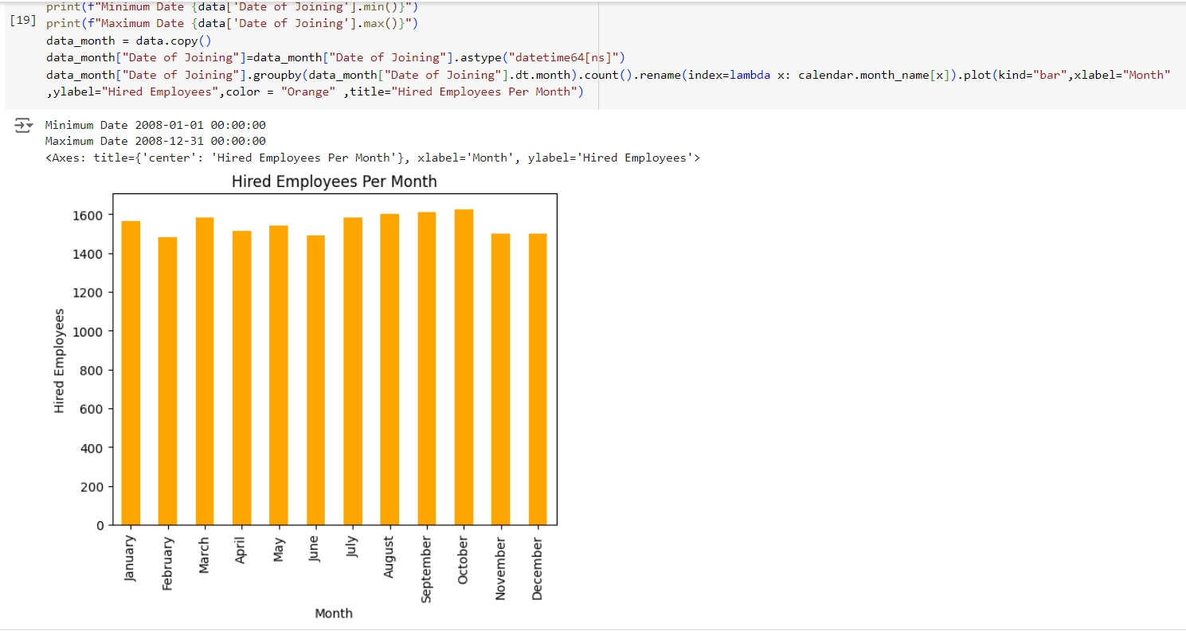
Result

Slide 9
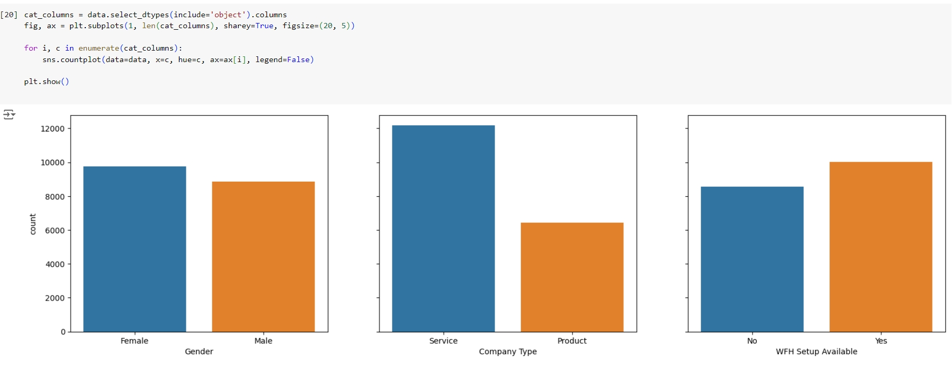

Slide 10
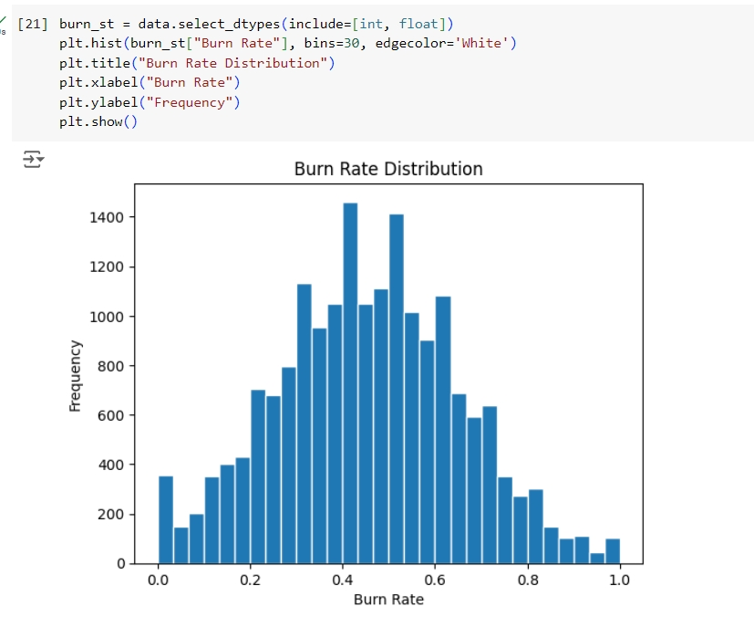

Slide 11
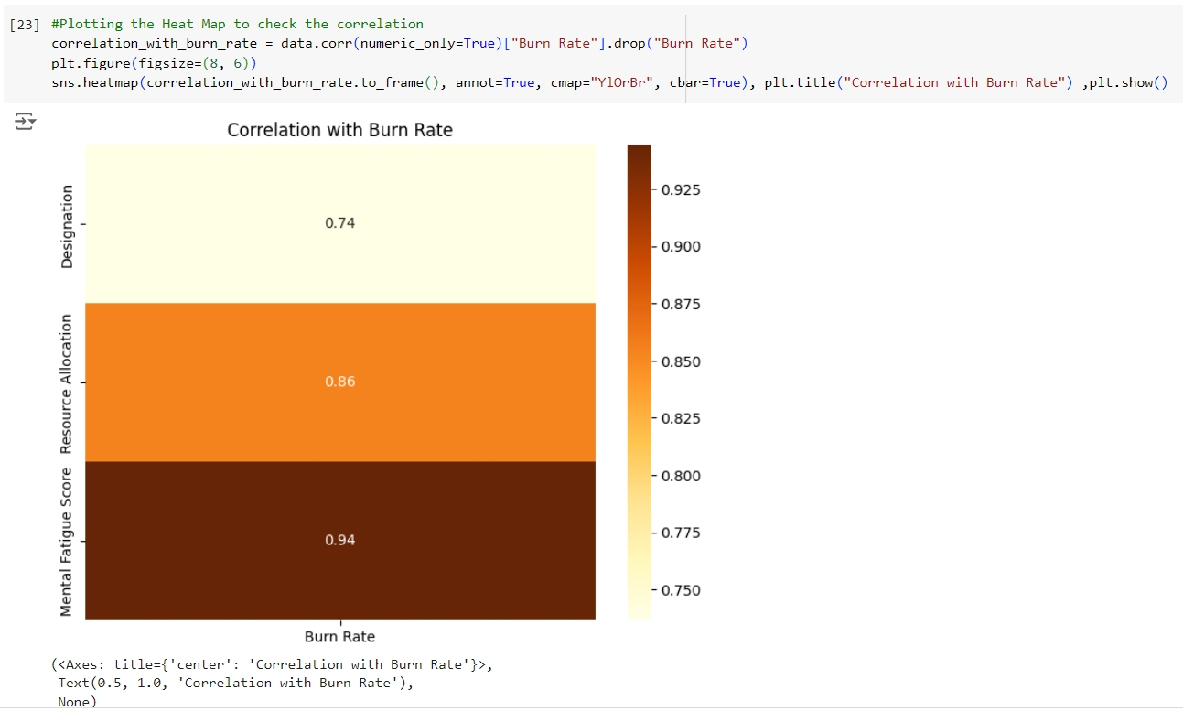

Slide 12
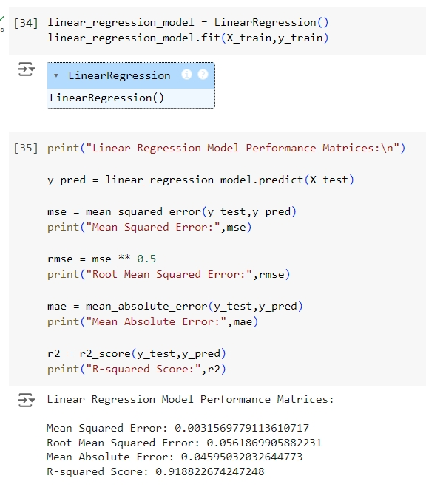
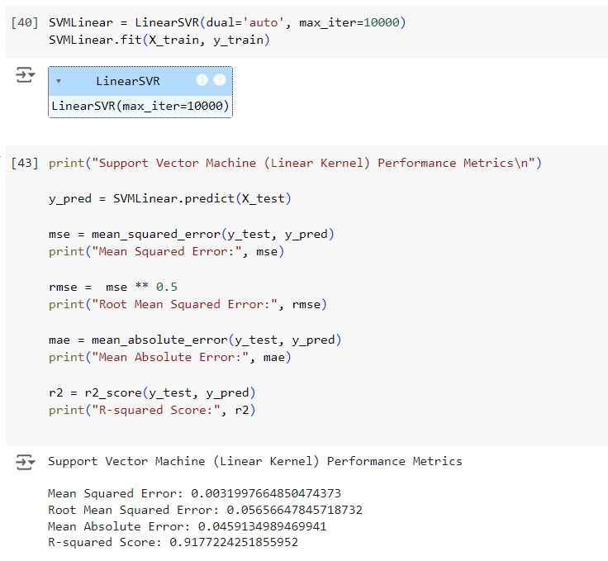
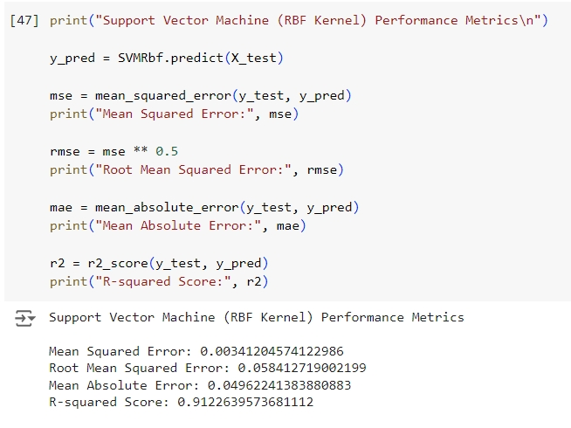

Slide 13
Github link :
SumithAshokShetty/Employee-Burnout-Analysis-and-Prediction: This repository contains the Employment Burnout Analysis project. This project focuses on analyzing employee burnout using machine learning techniques.

Slide 14
Future scope
The future scope of the Employee Burnout Analysis project lies in its potential to evolve into a more robust and comprehensive tool for organizations. Some areas for future development include:’
Incorporating real-time employee data from surveys, work hours, and performance metrics can allow the model to provide immediate burnout predictions and feedback.
Exploring more advanced machine learning models, such as decision trees, random forests, or neural networks, could improve the accuracy and predictive power of the analysis.
The model can be extended to not only predict burnout but also offer personalized recommendations to both employees and managers for stress reduction and workload management.
Implementing a feedback loop where the model’s predictions and recommendations are continuously updated based on new employee data can improve the model’s accuracy over time.

Slide 15
Conclusion
The Employee Burnout Analysis project successfully demonstrates the use of machine learning to predict and understand the factors contributing to employee burnout. By leveraging data manipulation, preprocessing, and regression techniques, we were able to build a model capable of providing insights into the key drivers of burnout within an organization. The project utilized powerful libraries such as pandas, matplotlib, seaborn, plotly, and scikit-learn, enabling efficient data handling, visualization, and model evaluation. Through rigorous data preprocessing ,the model was trained and tested to predict employee burnout levels with acceptable accuracy, evaluated through metrics like mean squared error, R2 score, and mean absolute error. In conclusion, this project not only highlights the power of machine learning in tackling real-world problems but also emphasizes the importance of data-driven decision-making for improving employee health and productivity in the workplace.

Slide 16
References
pandas - Python Data Analysis Library
Matplotlib — Visualization with Python
seaborn: statistical data visualization — seaborn 0.13.2 documentation
scikit-learn: machine learning in Python — scikit-learn 1.6.0 documentation
LinearRegression — scikit-learn 1.6.0 documentation
LinearSVR — scikit-learn 1.6.0 documentation

Slide 17
THANK YOU

